Slide 1
Building Early Literacy Skills
KinderStart Parent/ Caregiver Presentation

Slide 2
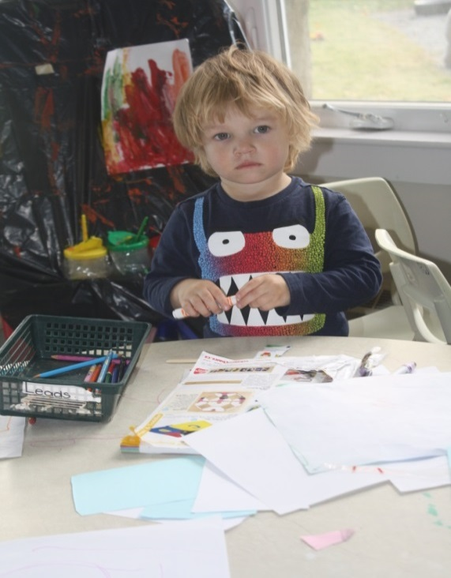
Early Literacy
Early Literacy begins at birth and quickly expands within the first six years.
It includes the knowledge necessary to learn to:
Communicate
Read
Write
Think
Explore, and
Solve problems

Slide 3
Basic Early Literacy Skills
Print Motivation: an interest in and an enjoyment of books
Print Awareness: notice printed words everywhere, know how to handle a book and how to follow the words on a page
Narrative Skills: ability to describe things and events and tell stories in sequence

Slide 4
Phonological Awareness: ability to hear and manipulate the smaller sounds in words
Letter Knowledge: knowing that letters look different from each other and have different names and sounds
Vocabulary: knowing many different words

Slide 5
Building Early Literacy Skills
Play
Talk
Sing
Read
Write

Slide 6
Talk
Talking is how children learn spoken language.
With lots of opportunity to hear and speak language and/or to communicate in non-verbal ways, children learn important things about the world around them.

Slide 7
It is important to:
Introduce new words.
Expand on what your child says.
Talk coupled with reading, or read to initiate talk or discussion.
Have time to talk to your children every day. Make sure you respond to them.
Indulge in pretend play with children. Encourage them to act out someone.

Slide 8
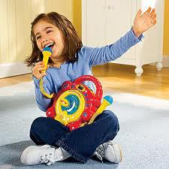
Sing
Singing and rhyming help children hear the smaller sounds in words.
It is also fun and engaging way to learn language, communicate and express oneself.

Slide 9
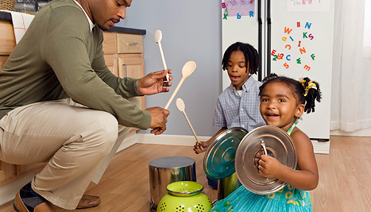
It is important to:
Sing, dance and clap as you enjoy the singing activities for each book.
Adjust the speed and volume to fit their abilities when you sing with young children.
Introduce and talk about new words in song lyrics and talk about what they mean.

Slide 10
Create individualized songs that will engage children and boost their memories. Fill your songs with people (family members, teachers or friends), objects (clothing, furniture, cars or bikes), daily routines (brushing teeth, bedtime), and special events (holidays, birthdays) that children can connect with.
Sing with actions as much as possible.
Appreciate what they sing.

Slide 11
Read
Reading together is one of the most important things you can do to prepare children for the transition to school.
It helps children become familiar with print and to understand that print words have meaning.

Slide 12
It is important to:
Know what interests your child and read accordingly.
Help your child learn how print works. Point to the text as you read.
Ask open-ended questions while reading the stories.
Notes:
Show them differences between pictures and print, and how books in English are read from left to right, top to bottom.
Provide them opportunities to predict what is going to happen next. Engage with them in conversations.

Slide 13
Look at the pictures together and notice expressions of characters, and expression words in the stories.
Discuss unfamiliar words.
Encourage children to retell the stories by looking at the pictures.
Act out the story while reading by using facial expressions, gestures, body movements, and voices.
Visit your local library and explore the world of books.

Slide 14
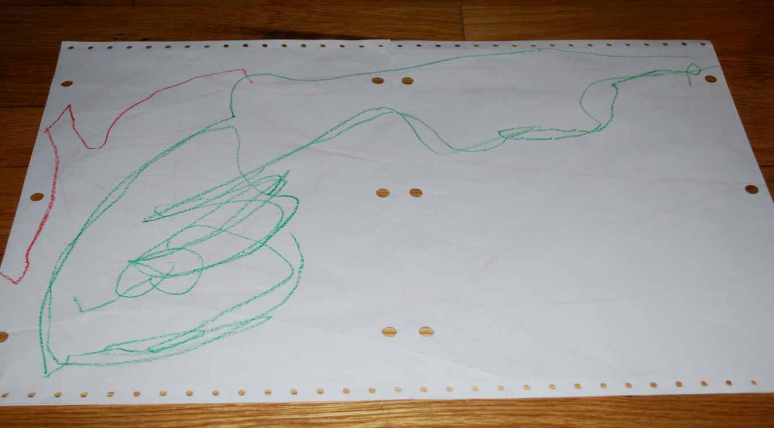
Write
Opportunities to scribble, paint, draw, and write help children represent their ideas and words in meaningful ways.

Slide 15
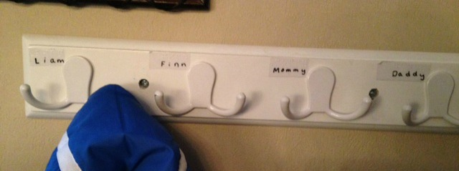
It is important to :
Provide opportunities to your child to scribble, draw and colour using crayons, pencil, KinderStart Journal, and erase board provided in the KinderStart bag.
Capitalize on environmental print for early literacy development.
Write in front of your child and talk about it.
Notes:
Take children on neighbourhood or school walks and draw attention to purposes and meanings of signs.

Slide 16
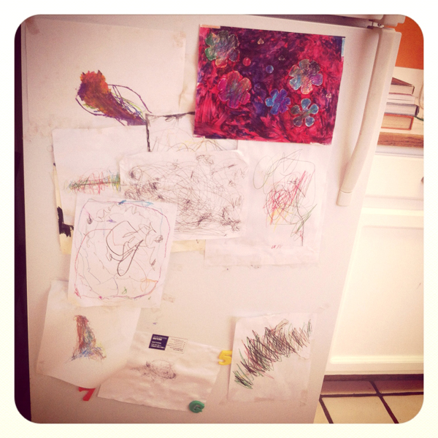
Encourage children to create greeting cards for special occasions. Show them old cards with phrases like “Happy Birthday”, “I Love you”, and “Season’s Greetings” to copy on their cards.
Encourage all writing efforts and display children’s writing.

Slide 17
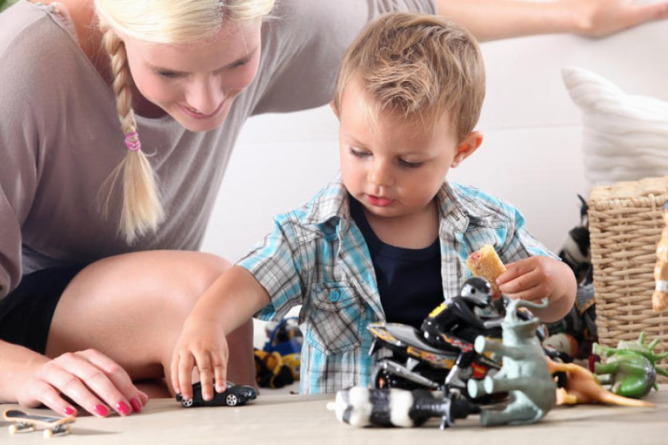
Play
Playing is how children discover, explore and understand the world and their place in it.

Slide 18
It is important to:
Provide them with resources, time, space and your company to play.
Provide opportunities to your child for various types of play- indoor, outdoor, solitary, group, dramatic, physical, constructive, creative, and games with rules.
Encourage your child to use the resources provided in the bag- the play item, crayons, clay, paints, construction paper, activity/craft mat.

Slide 19
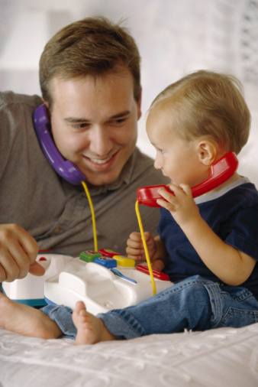
Acknowledge and praise your child’s creative work and post it for everyone to see.
Be active and explore interesting and fun ways to play with your.

Slide 20
For more information
Please visit-
http://www.ed.gov.nl.ca/edu/earlychildhood/index.html

Slide 21
Thank you for your time.

